Slide 1
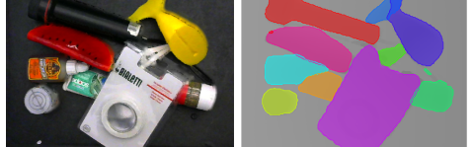
Segmenting Unknown 3D Objects from Real Depth Images using Mask R-CNN Trained on Synthetic Data (SD-MaskRCNN)
Ping-Cheng Wei

Slide 2
Abstract
This is the first implementation of SD-MaskRCNN, which is an instance segmentation model based on Mask RCNN. We name this implementation as Experiment 1.
The idea behind instance segmentation is to let the model achieve higher pixel-level detection instead of just traditional object detection with bonding box. This will not only benefit us with higher accuracy and precision of detection of each instance/object but also enble in our task, Binpicking, much more futher development such as center point detcetion, better decision of grasping point and better grasping angle.
In this report the following topics would be explained:
Implementation
Results
Theory of Mask RCNN
Theory of SD-MaskRCNN
My contribution

Slide 3
Implementaion – Enviroment & Dataset
This Experiment 1 SD-MaskRCNN model is tested and trained against the following enviroment:
For this experiment 1 we exploit all depth images and instance segmentation masks of Dexnet objects and seperate them into training and testing dataset. For training dataset we randomly pick images and generate the train_indices.npy file for train & test_indices.npy file for validation
Training dataset:
Total depth images: 6526, among of which 5520 for training and 1006 for validation
Objects: Dexnet Bar Clamp, Climbing Hold, Mount 2, Nozzle, Pipe Connector, U2, Part 1
Testing dataset:
Total depth images: 918
Objects: Dexnet Vase
Each depth image shape => (480, 840, 4)
GPU GeForce GTX 1080 Ti | Python 3.7.10
Ubuntu 18.04.5 LTS | Tensorflow 2.5.0
Nvidia CUDA 11.2 & cuDNN 8.1 | Keras 2.5.0

Slide 4
Implementaion – Training Process
Since we want our model to be capable to detect most of the objects and could be applied in general cases, which means it has to learn lots of features, we decide to use ResNet 101 for our model‘s backbone. Although it might slow down the detection speed, we gain higher accuracy. Moreover, in order to speed up the whole training process, we use transfer learning based on the COCO pre-trained weights.
Parameter setting in config file (binpicking_train.yaml):
Model weights: COCO (mask_rcnn_coco.h5)
Epoch: 80
Backbone: ResNet 101
Image per GPU: 4 , after several tests 4 is the maximum capability for our GPU
Learning rate: 0.001
Image shape: (512, 512)
For each epoch it takes around 1 hour and 15 minutes
Final loss after 80 epochs: around 0.2
Final validation loss after 80 epochs: also around 0.2

Slide 5
Implementaion – Instance Segmentation detection
We test our retrained model on 3 different objects, namely Dexnet Vase, the original testing dataset, Dexnet U2 and Part PW1. Each object has a different meaning to test and evaluate our model, which is shown in the title of results
For each test object we do 4 different detection, that is with packaging, without packaging, filtered BG, unfiltered BG. Background (BG) at here means true background, package and box.
The different between filtering BG and unfiltering BG is whether the binary masks (semantic masks) are provided. Since our original dataset only include the instance segmantation masks, we have written a new script “SemanticMask_generation.py“ to enable all semantic masks generation of a dataset by providing the root directory of an instance segmantation masks. If semantic masks are provided, our SD-MaskRCNN model could then filter out the BG and show better visualization of the results.
Instance segmentation mask detection speed per image: around 13 ms
Visualization speed per image: around 500 ms
Reminder: In the case that ground truth of segmantation masks aren‘t provided, like realtime running, video detection or our binpicking task, which means we don‘t have semantic masks, then our prediction will be instance segmentation with unfiltered BG

Slide 6
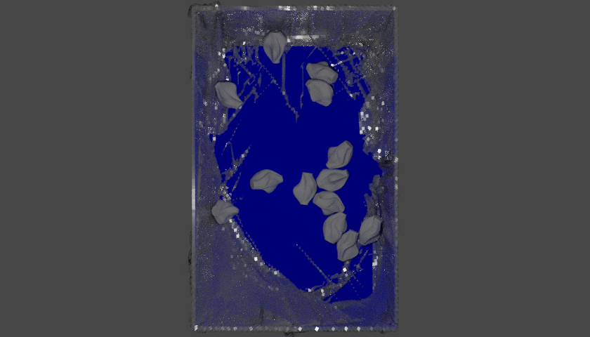
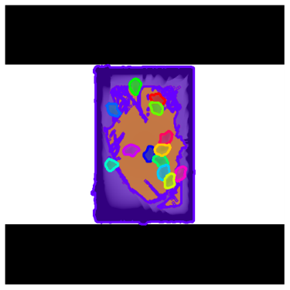
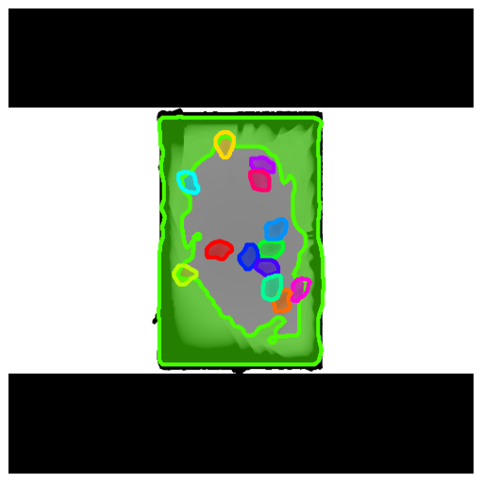
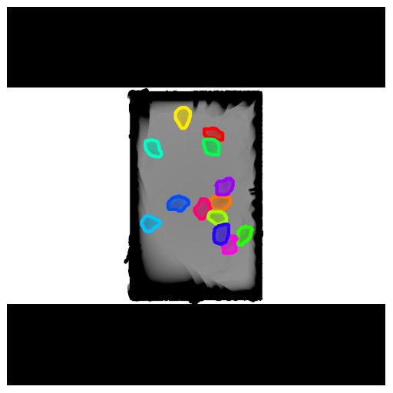
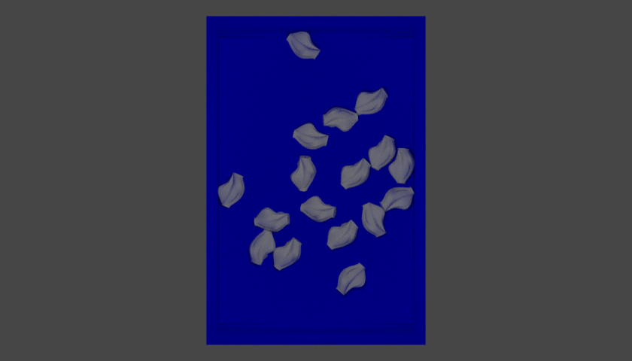
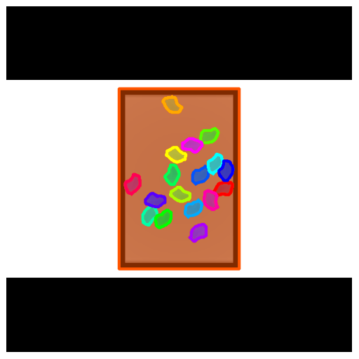
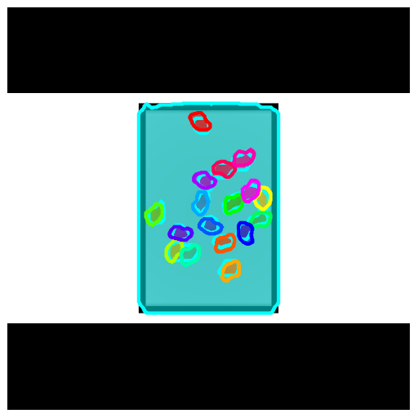
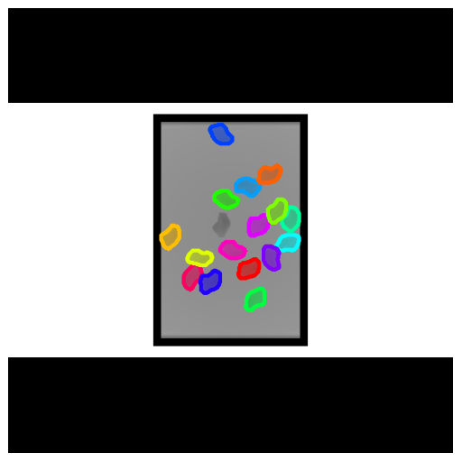
Results – Dexnet Vase (unseen object)
Simple - level
 | RGB Image | Ground Truth | Predict(no filtered) | Predict (filtered)
Package
Without Package

Slide 7
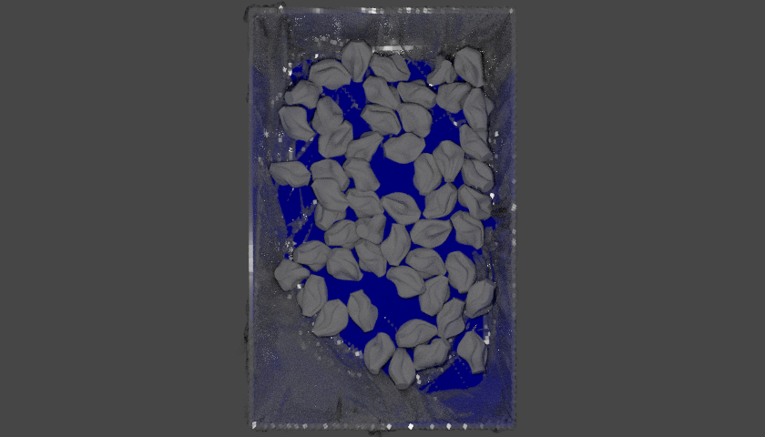
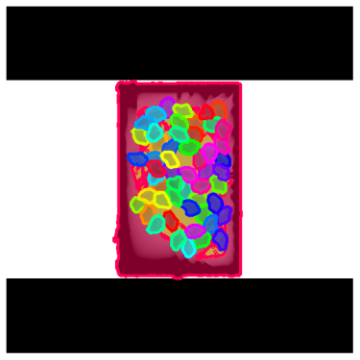
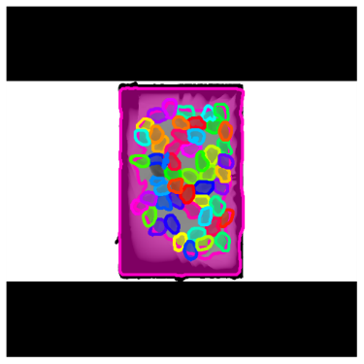
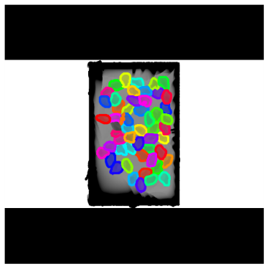
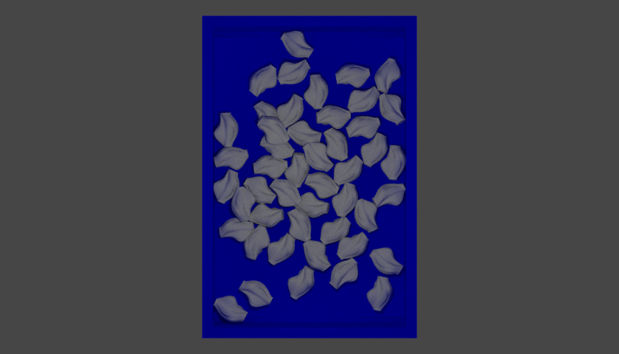
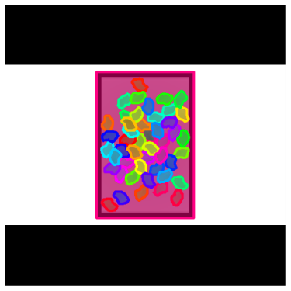
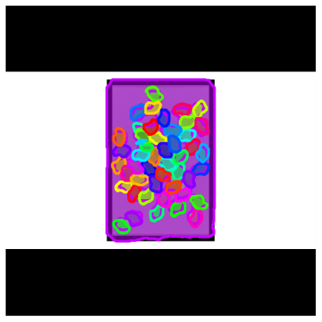
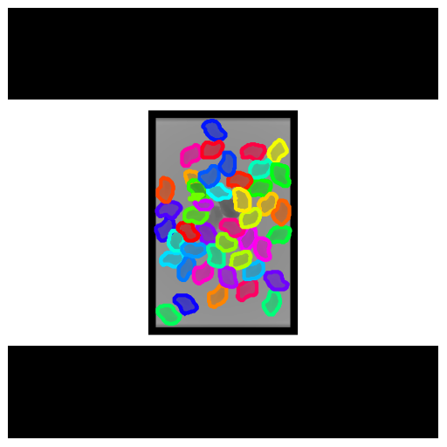
Results – Dexnet Vase (unseen object)
Middle - level
 | RGB Image | Ground Truth | Predict(no filtered) | Predict (filtered)
Package
Without Package

Slide 8
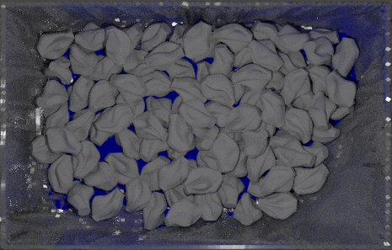
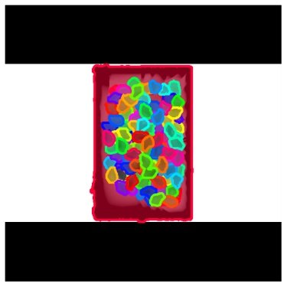
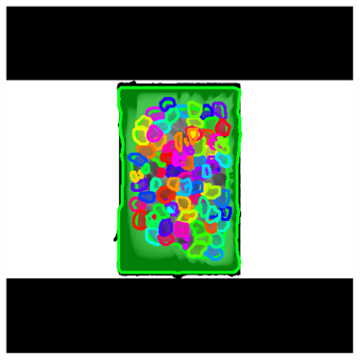
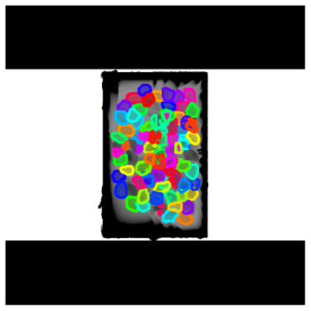
Results – Dexnet Vase (unseen object)
Challenge - level
 | RGB Image | Ground Truth | Predict(no filtered) | Predict (filtered)
Package

Slide 9
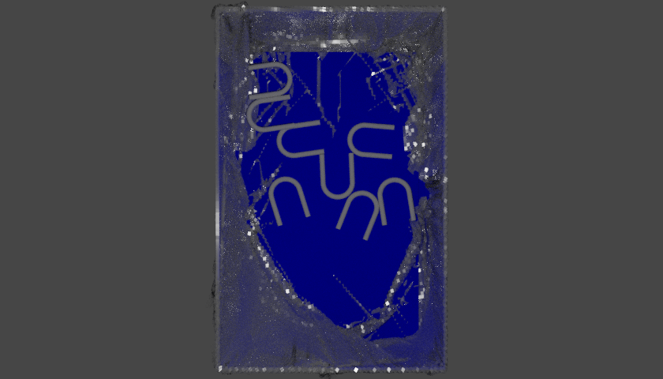
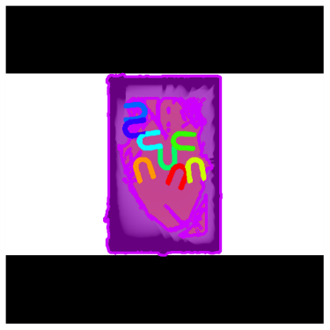
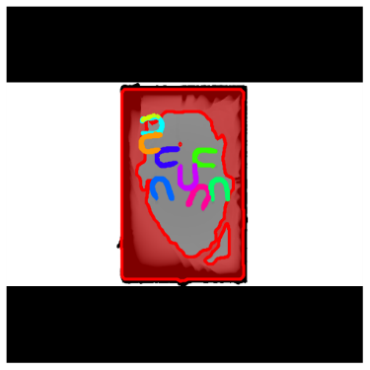
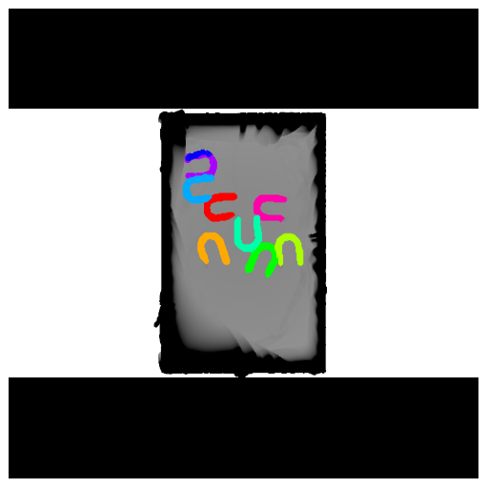
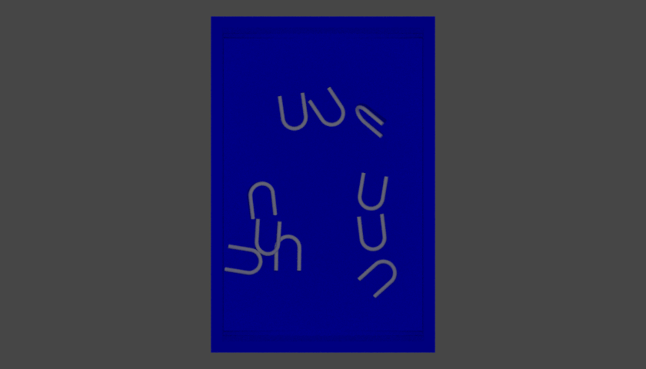
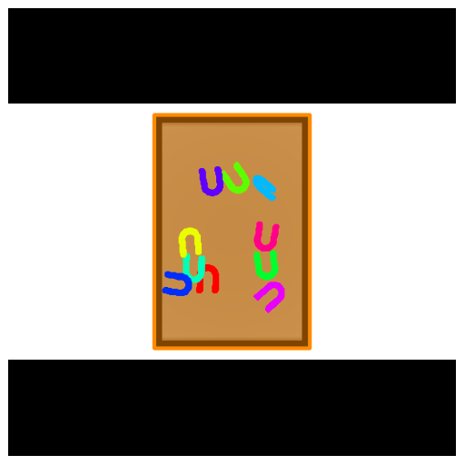
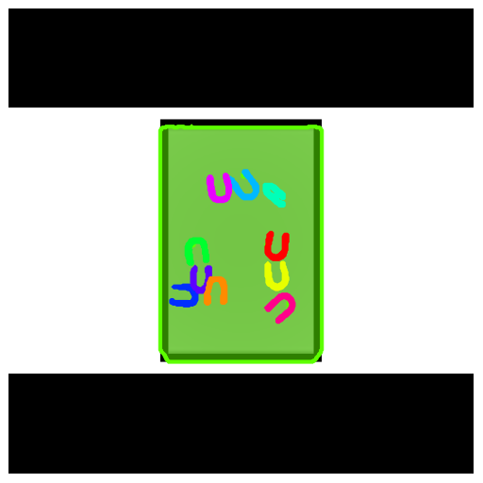
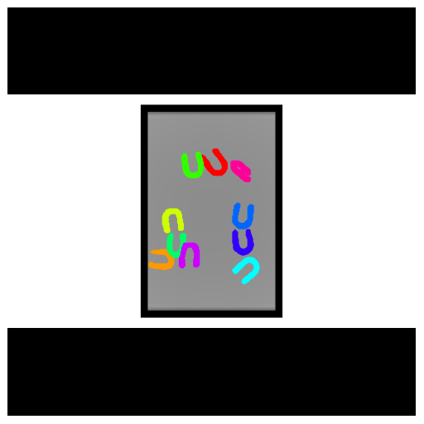
Results – Dexnet U2 (seen, but still challenging object)
Simple - level
 | RGB Image | Ground Truth | Predict(no filtered) | Predict (filtered)
Package
Without Package

Slide 10
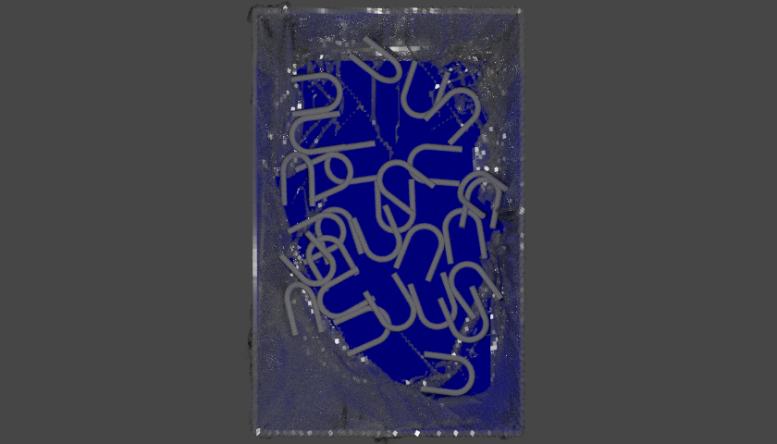
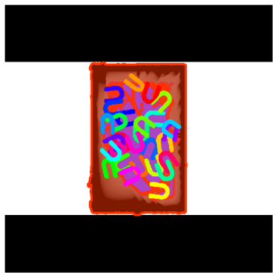
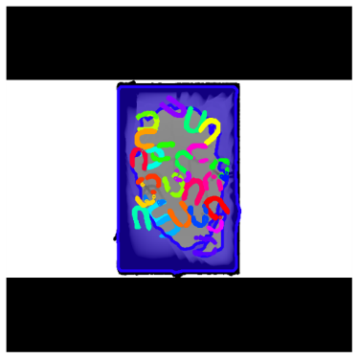
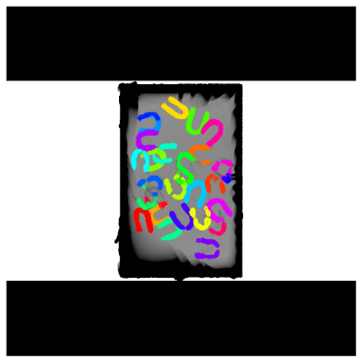
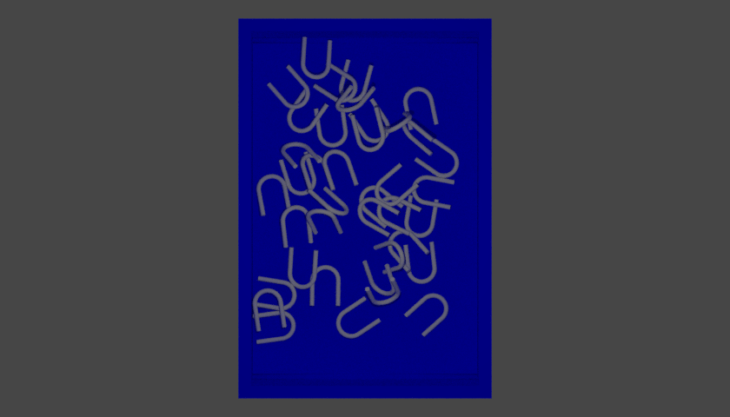

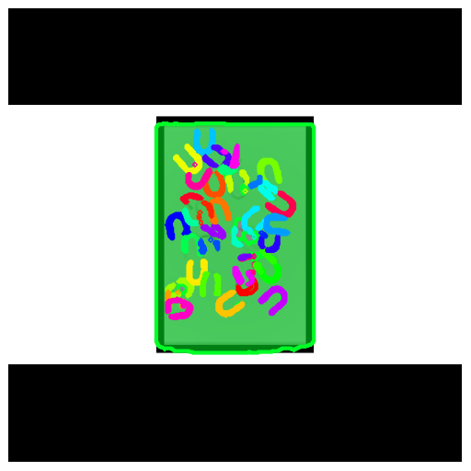
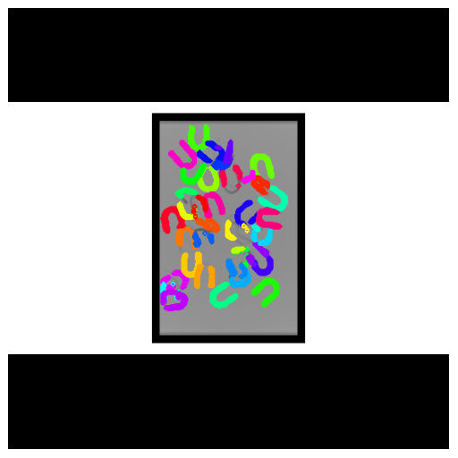
Results – Dexnet U2 (seen, but still challenging object)
Middle - level
 | RGB Image | Ground Truth | Predict(no filtered) | Predict (filtered)
Package
Without Package

Slide 11
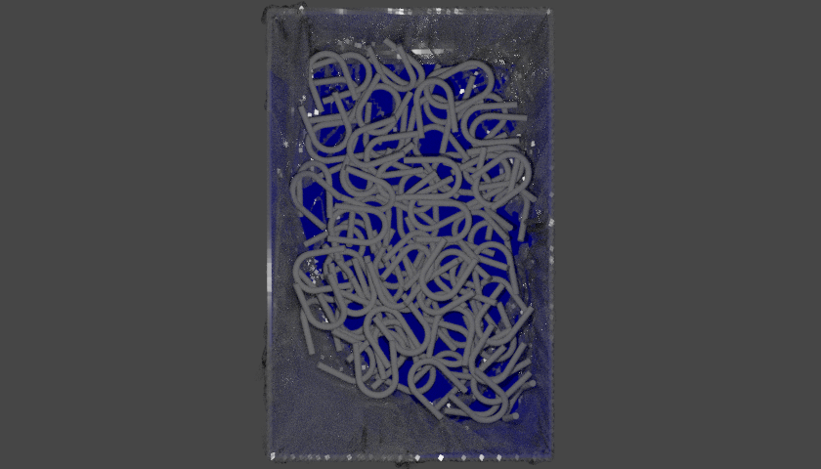
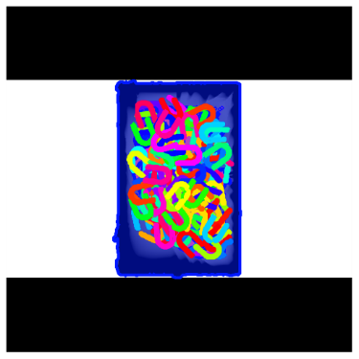
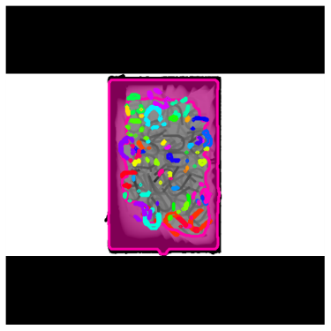
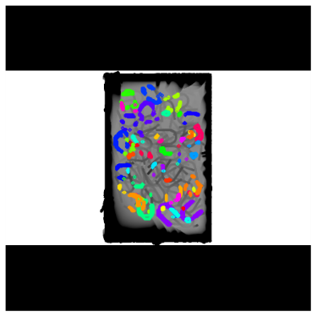
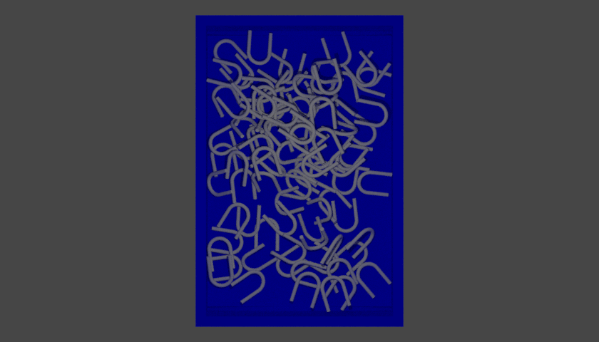
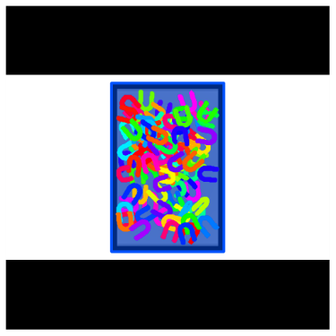
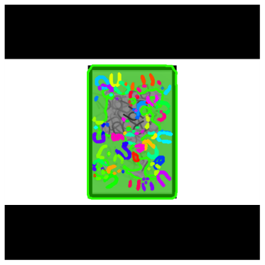
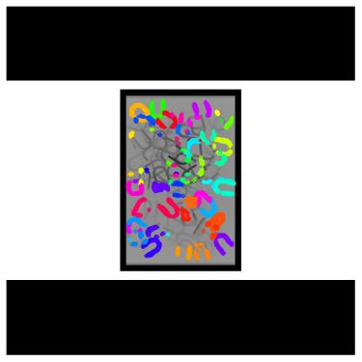
Results – Dexnet U2 (seen, but still challenging object)
Challenge - level
 | RGB Image | Ground Truth | Predict(no filtered) | Predict (filtered)
Package
Without Package

Slide 12
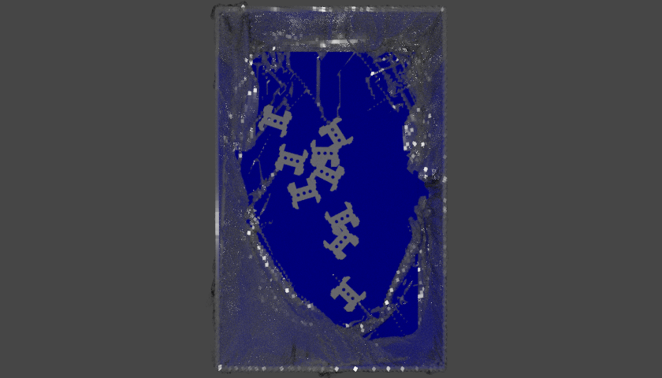
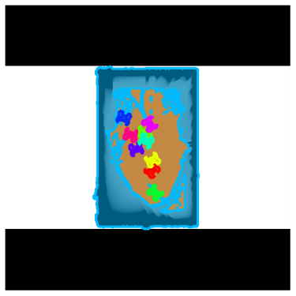
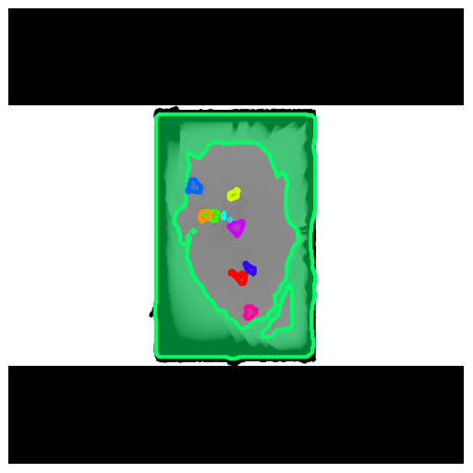
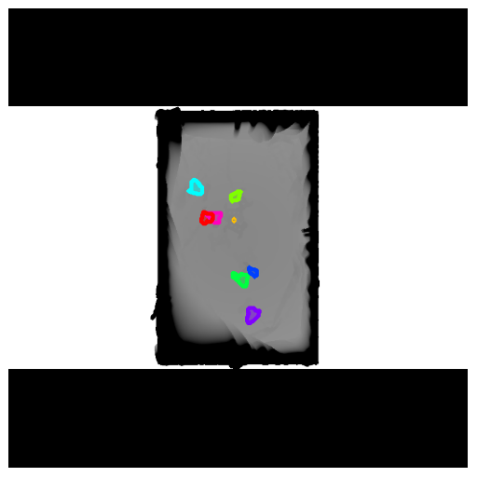
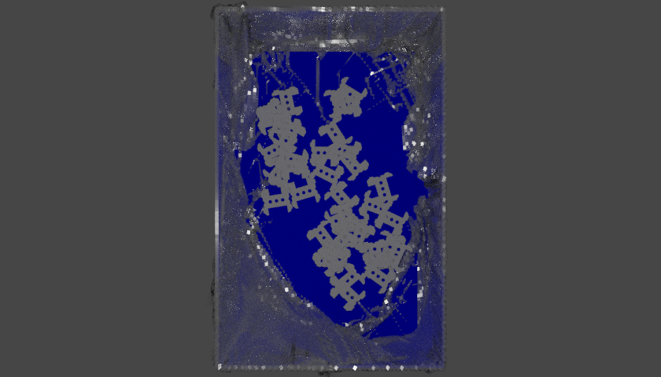
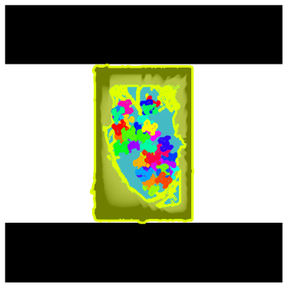


Results – Part PW1 (unseen & Challenging object)
With packaging
Level | RGB Image | Ground Truth | Predict(no filtered) | Predict (filtered)
simple
middle

Slide 13

Theory of Mask RCNN
Overall architecture of Mask RCNN
Basically, we could seperate the Mask RCNN into the following parts:
Backbone: ResNet 35, ResNet 50, ResNet 101
Feature Pyramid Network (FPN)
Region Proposal Network (RPN)
Region Of Interest (ROI)
Detection Layer
Class Prediciton
Bonding Box Prediction
Mask Prediction
Backbone
FPN
RPN
Feature maps
Detection Layer
Feature maps
ROI

Slide 14
Theory of Mask RCNN
Overall architecture of Mask RCNN
The overall steps of training process:
Extract features through backbone and FPN
Generate anchors and make binary as well as bonding box predictions in RPN
Filter the predictions and generate final proposals in ROI
Combine the proposals and feature maps
Run through detection layer to make class, bonding box, mask predictions
https://engineering.matterport.com/splash-of-color-instance-segmentation-with-mask-r-cnn-and-tensorflow-7c761e238b46
https://alittlepain833.medium.com/simple-understanding-of-mask-rcnn-134b5b330e95
https://zhuanlan.zhihu.com/p/349584827
Backbone
FPN
RPN
Feature maps
Detection Layer
Feature maps
ROI

Slide 15



Theory of Mask RCNN – Backbone & Feature Pyramid Network (FPN)
The main idea of using backbone structure like ResNet 101 is to extract the features from the image through multiple CNN layers. However, instead of just a single backbone Mask RCNN prefers to use FPN to strengthen the feature extraction because there might have some feature losses during the downsampling in CNN layers.
For each block in each identity block, we have the structuer like this
ResNet 101 Architecture without FC layer at the end
FPN Architecture

Slide 16

Theory of Mask RCNN – Region Proposal Network & Region Of Interest
The RPN is a lightweight neural network that scans the input feature maps from previous FPN through a sliding-window and create anchors and finds areas that contain objects. Therefore, the RPN outputs two thing: the predictions of object coordinate and the probabilities of existence of object.
After RPN, the ROI filters the generated predictions dependent on the scores and picks the top k predicted coordinates. These predictions are then filtered by non-maximum suppression (NMS) to generate the final proposed coordinates (default 2000).
The coordinate at here means the coordinate of the feature maps where object could exist.
Size of RPN outputs:
rpn_class_logits = [batch, anchors, 2]
rpn_probs = [batch, anchors, 2] (probs of object, no object)
rpn_bbox = [batch, anchors, 4] (coordinates => y1, x1, y2, x2)
proposals = [batch, NMS_ROIS, 4] (coordinates => y1, x1, y2, x2)

Slide 17

Theory of Mask RCNN – Detection Layer
By combining the predicted coordinates from ROIs and feature maps from FPN, detection layer then runs through different convolutional layers, fully connected layer to generate the final class, bonding box and mask predictions of original input image.

Slide 18
Theory of SD-MaskRCNN
Basically, the model of SD-MaskRCNN is based on mask RCNN. But with the main two following changes:
Instead of training on RBG image, SD-MaskRCNN trains on depth images and triplicate the depth values to treat them as grayscale images
Output classes are 2, which means background and object
Due to the ability of instance segmentation of Mask RCNN and ouput 2 classes feature, SD-MaskRCNN is capable to seperate the foreground successfully from the background and mark each different object as well as instances in same object with different labels and colors
Other contributions from SD-MaskRCNN:
Provide a better way to set all the parameters for training & testing by inputting a config file to the model
Provide augmentation, resize script for better training results
Create a function to be able to run the inference on a whole testing dataset
Create a function to filter out the BG in visualization if semantic masks are provided
Dataset generation script, which automatically creates depth images and object masks using simulated heaps of 3D CAD models

Slide 19
My Contribution
Configured the whole python enviroment so that the model could be able to run libraries such as TensorFlow 2 and reinstall the correct version of CUDA & cuDNN to enble training on GPU
Edited the script from Mask RCNN based on tensorflow 1 to be compatible with tensorflow 2. For example:
import keras.layers as KL → import tensorflow.keras.layers as KL
Add tf.compat.v1.disable_eager_execution() on top of the script
tf.where tf.compat.v1.where
Comment out “self.keras_model._losses = []“ & “self.keras_model._per_input_losses = {}“
Tested the Mask RCNN TF2 version on ballon dataset samples and it works successfully
Tested the SD-MaskRCNN based on the benchmark wisdom dataset and pretrained weights
Created a new function called “visualize_inferences“ to let SD-MaskRCNN run the inferences on a dataset, which doesn‘t have ground truth instance masks
Created a new script called “detection.py“ and config file called “binpicking_test.yaml“ so that SD-MaskRCNN could be able to run on single image, video, webcam (real-time) and a whole dataset either with or without ground truth instance masks

Slide 20
My Contribution
Fix the problem that the model can‘t read the instance segmentation masks of size (h, w, 3) or (h, w, 4)
Created a detailed instruction of SD-MaskRCNN and Mask RCNN in Git and uploaded all code and data
Wrote a script called “SemanticMask_generation.py“ to generate the semantic masks from provided root directory of instance segmentation masks of a dataset and store it in folder “segmasks_filled“. With generated semantic masks we could filter out the BG during the visualization
Wrote a script called “Dataset_generation.py“, to automatically collect and rename all the depth images, RGB images and instance masks from numerous folders, upon of which contains images from different object. The script will also seperate the images into training dataset or testing dataset by given the name of test object folder and create the “train_indices.npy“ and “test_indices.npy“, which includes the random indices of images
Wrote a script called “rename_images.py“, that automatically rename all the images in a root directory to “image_{index}“ to match the format requirement of SD-MaskRCNN since part of the model runs the images dependent on the index if you run the model on a dataset. It also creates the indices file for testing on a dataset
Generated the training and testing dataset based on Dexinet objects for SD-MaskRCNN Experiment 1

